Slide 2

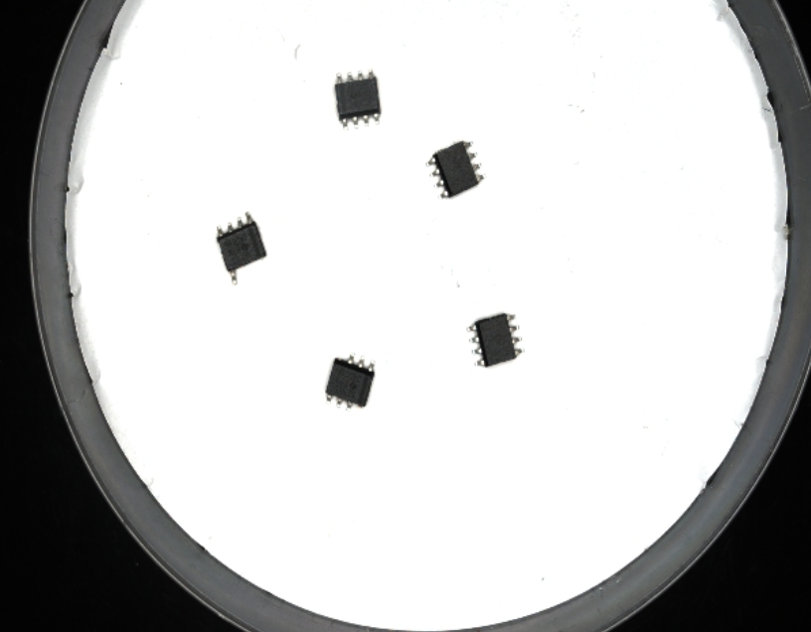
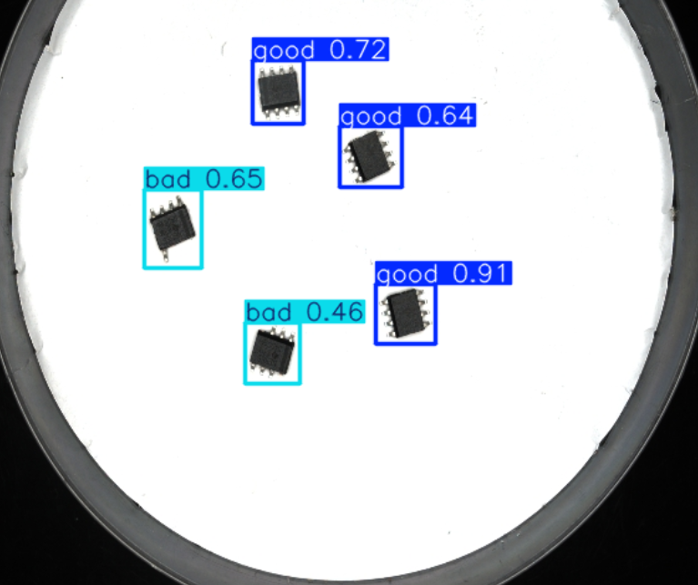
芯片检测演示 | Chip detection demonstration
Original image
Detected Image

Slide 3
模型训练流程 | Model training process
数据采集
数据标注
模型训练
模型测试
Data Collection
Data Annotation
Model Training
Model Testing

Slide 4
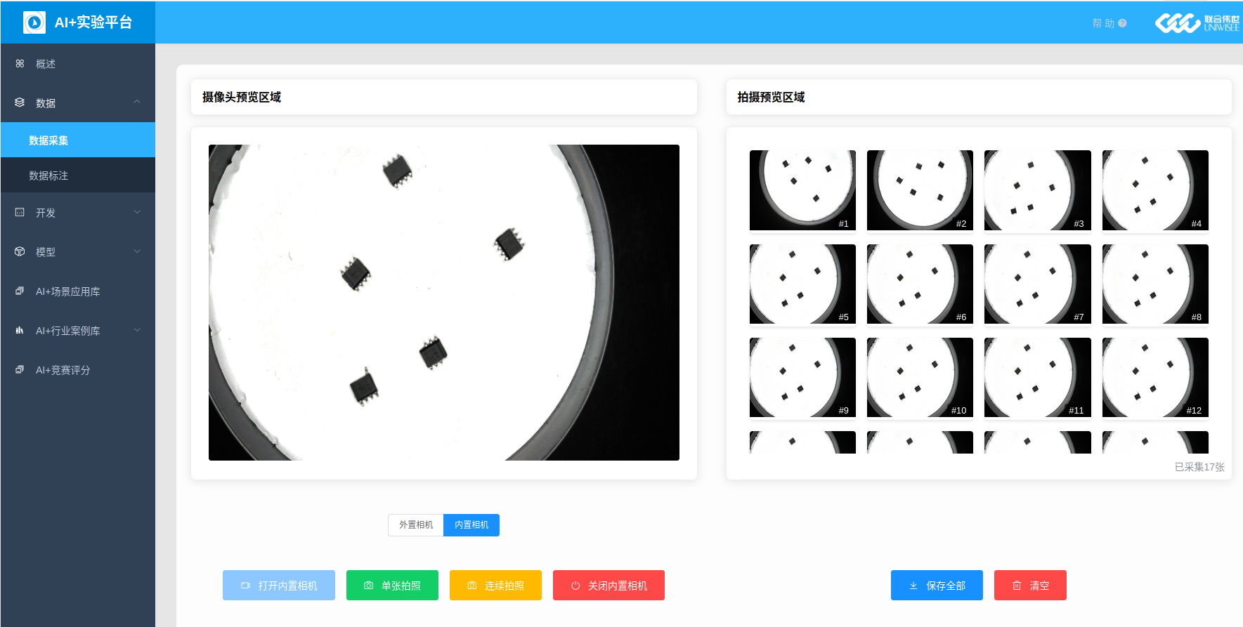
第一步：数据采集 | Step 1: Data Collection

Slide 5
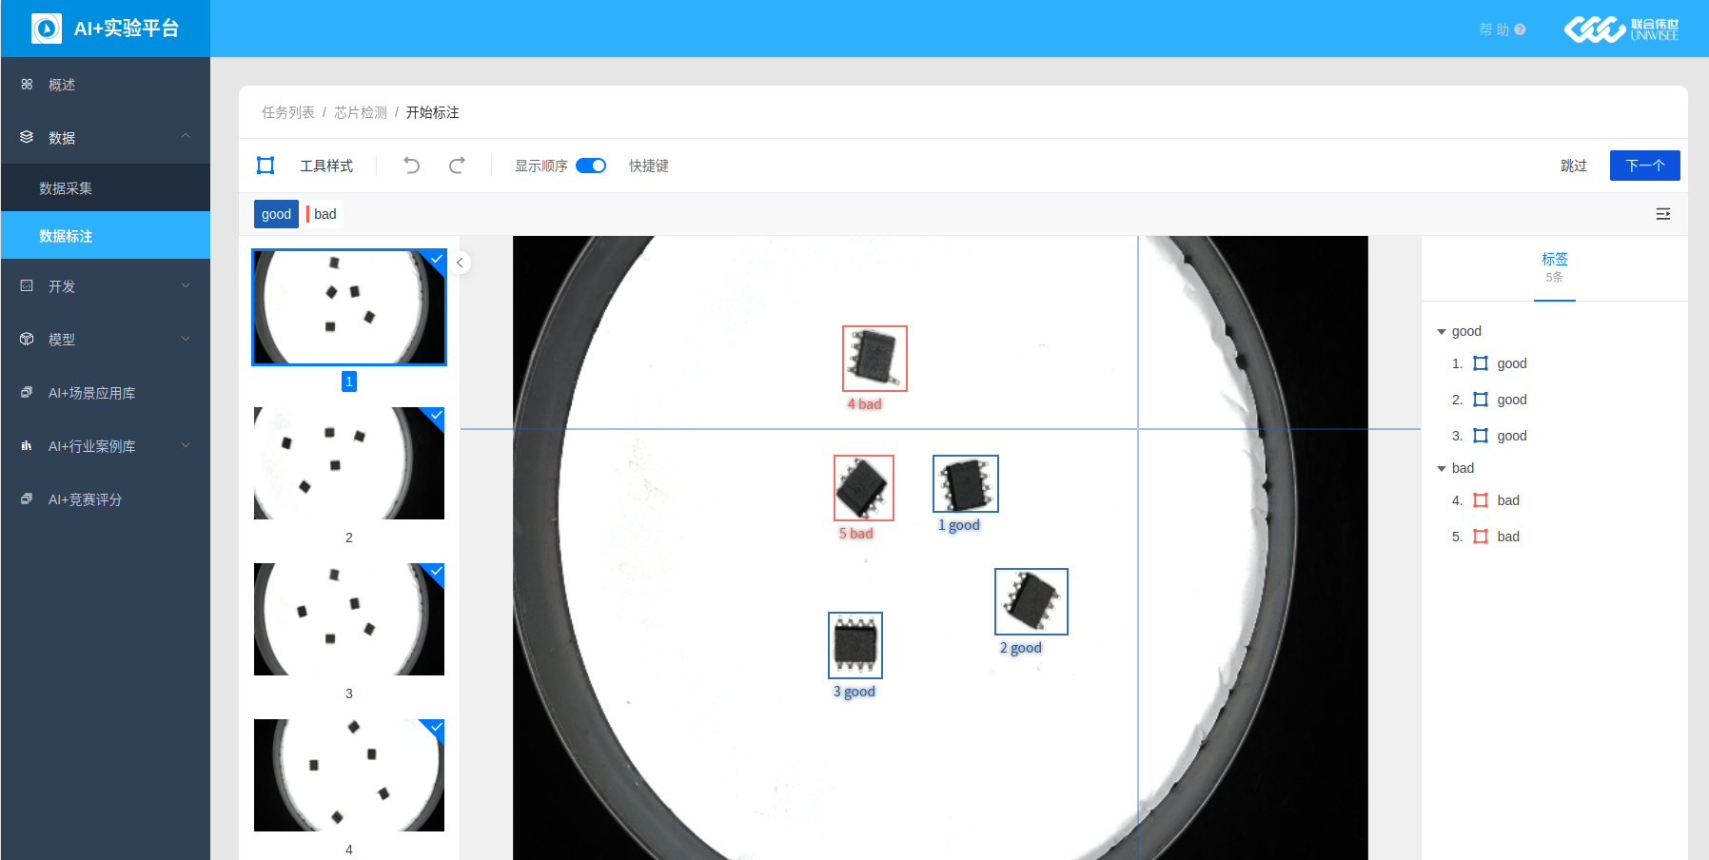
第二步：数据标注 | Step 2: Data Annotation

Slide 6
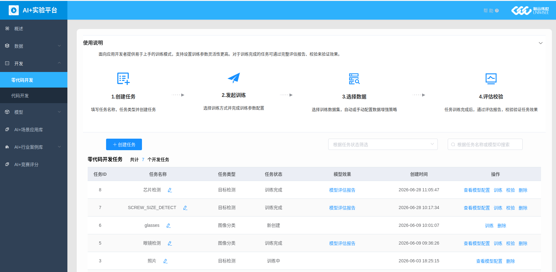
第三步：模型训练 | Step 3: Model Training

Slide 7
芯片检测结果 | Chip detection results
Original image
Detected Image

Slide 8
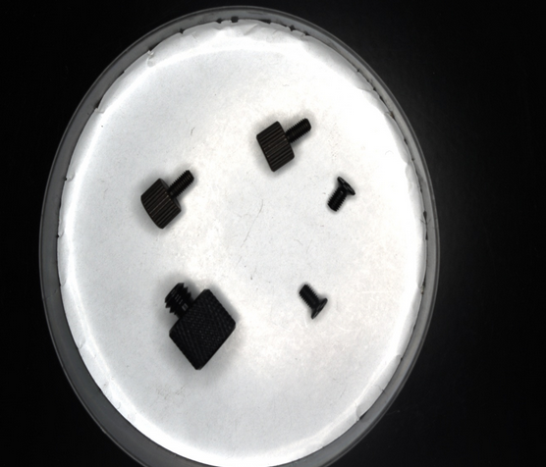
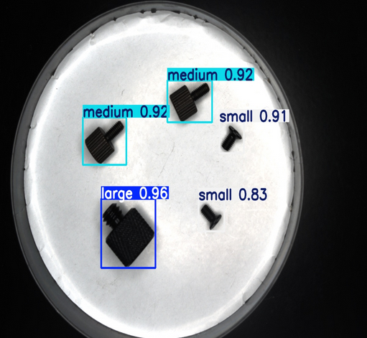
New Model Training Task (Following the Example) : Screw Size Detection
Original image
Detected Image

Slide 9
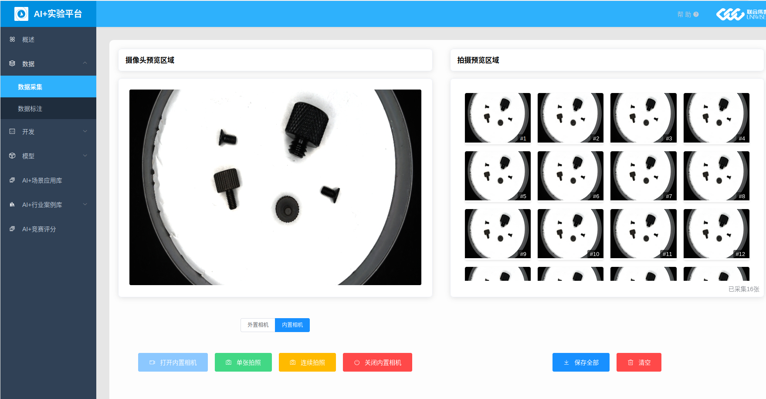
第一步：数据采集 | Step 1: Data Collection

Slide 10
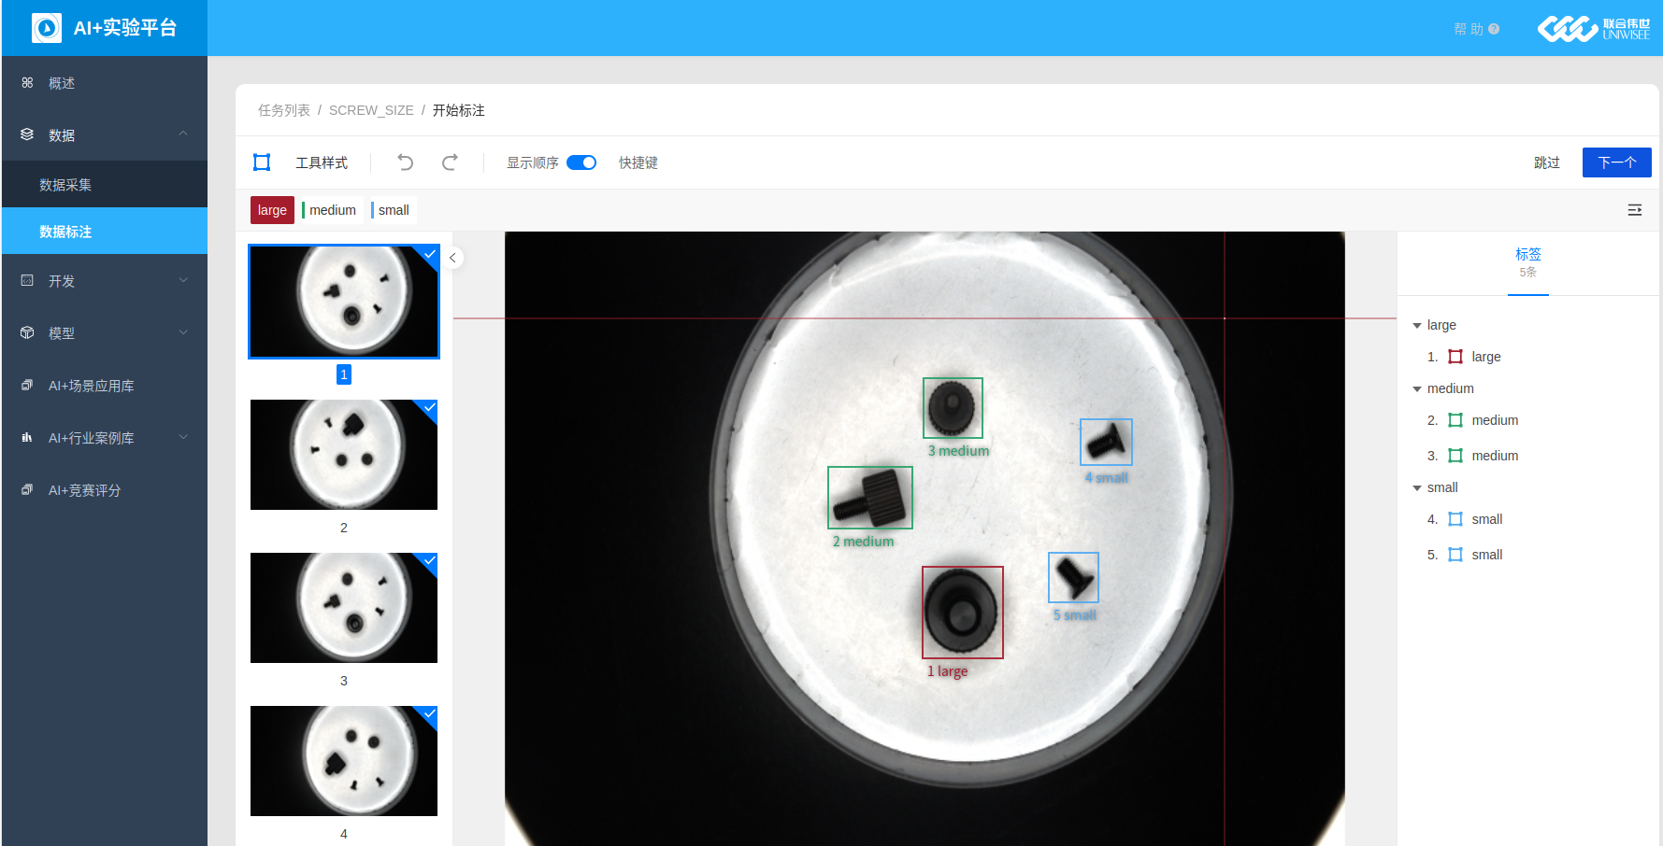
第二步：数据标注 | Step 2: Data Annotation

Slide 11
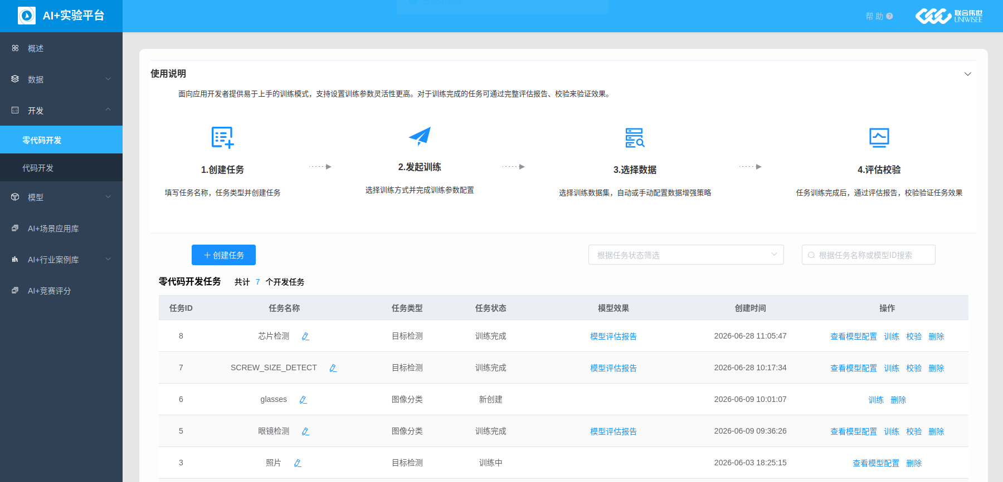
第三步：模型训练 | Step 3: Model Training

Slide 12
螺丝尺寸检测结果 | Screw size detection results
Original image
Detected Image

Slide 13
第四步：模型测试 | Step 4: Model Testing
Coming soon

